Slide 1
5:
Project Integration Management

Slide 2
Learning Objectives
Describe an overall framework for project integration management as it relates to the other project management knowledge areas and the project life cycle
Describe project plan development, including project plan content, using guidelines and templates for developing plans, and performing a stakeholder analysis to help manage relationships
Explain project plan execution, its relationship to project planning, the factors related to successful results, and tools and techniques to assist in project plan execution
Understand the integrated change control process, planning for and managing changes on information technology projects, and developing and using a change control system
Describe how software can assist in project integration management

Slide 3
The Key to Overall Project Success: Good Project Integration Management
Project managers must coordinate all of the other knowledge areas throughout a project’s life cycle
Many new project managers have trouble looking at the “big picture” and want to focus on too many details (See opening case for a real example)
Project integration management is not the same thing as software integration

Slide 4
Project Integration Management Processes
Project Plan Development: taking the results of other planning processes and putting them into a consistent, coherent document—the project plan
Project Plan Execution: carrying out the project plan
Integrated Change Control: coordinating changes across the entire project

Slide 5
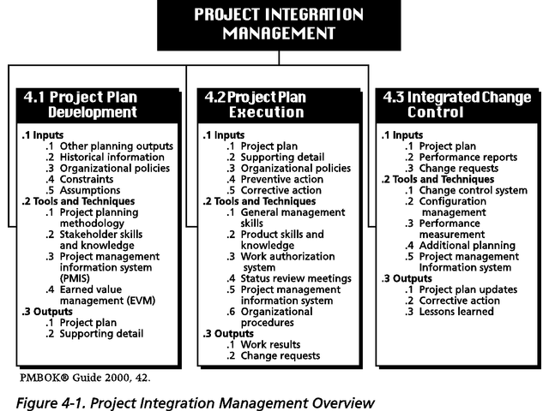
Figure 4-1. Project Integration Management Overview
Note: The PMBOK® Guide 2000 includes similar charts for each knowledge area.

Slide 6
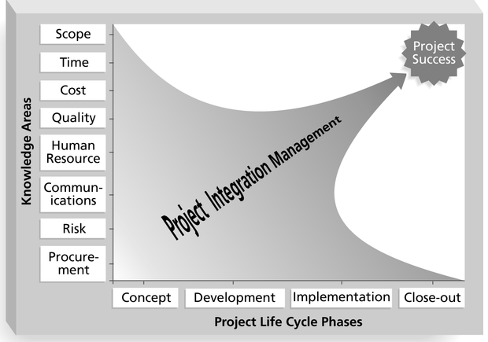
Figure 4-2. Framework for Project Integration Management
Focus on pulling everything to-
gether to reach project success!

Slide 7
Project Plan Development
A project plan is a document used to coordinate all project planning documents
Its main purpose is to guide project execution
Project plans assist the project manager in leading the project team and assessing project status
Project performance should be measured against a baseline plan

Slide 8
Attributes of Project Plans
Just as projects are unique, so are project plans
Plans should be dynamic
Plans should be flexible
Plans should be updated as changes occur
Plans should first and foremost guide project execution

Slide 9
Common Elements of a Project Plan
Introduction or overview of the project
Description of how the project is organized
Management and technical processes used on the project
Work to be done, schedule, and budget information

Slide 10
Introduction or overview of the project
The project name
A brief description of the project and the need it addresses
The sponsor’s name
The names of the project manager and key team members
Deliverables of the project
A list of important reference materials
A list of definitions and acronyms, if appropriate

Slide 11
Description of how the project is organized
Organizational charts
Project responsibilities
Other organizational or process related information

Slide 12
Management and technical processes used on the project
Management objectives
Project controls
Risk management
Project staffing
Technical processes

Slide 13
Work to be done
Major work packages
Key deliverables
Other work-related information

Slide 14
Project schedule information
Summary schedule
Detailed schedule
Other schedule-related information

Slide 15
Project budget
Summary budget
Detailed budget
Other budget-related information

Slide 16
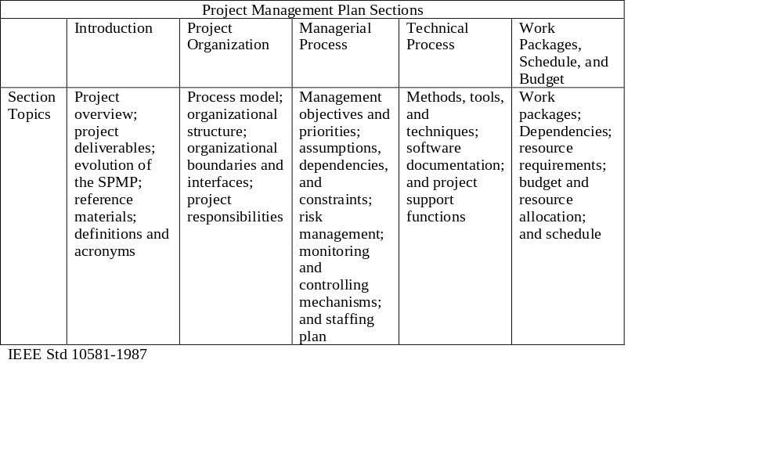
Table 4-1. Sample Outline for a Software Project Management Plan (SPMP)

Slide 17
What the Winners Do
"The winners clearly spell out what needs to be done in a project, by whom, when, and how. For this they use an integrated toolbox, including PM tools, methods, and techniques…If a scheduling template is developed and used over and over, it becomes a repeatable action that leads to higher productivity and lower uncertainty. Sure, using scheduling templates is neither a breakthrough nor a feat. But laggards exhibited almost no use of the templates. Rather, in constructing schedules their project managers started with a clean sheet, a clear waste of time." *
Milosevic, Dragan and And Ozbay. “Delivering Projects: What the
Winners Do.” Proceedings of the Project Management Institute Annual
Seminars & Symposium (November 2001)

Slide 18
Stakeholder Analysis
A stakeholder analysis documents important (often sensitive) information about stakeholders such as
  stakeholders’ names and organizations
  roles on the project
  unique facts about stakeholders
  level of influence and interest in the project
  suggestions for managing relationships

Slide 19
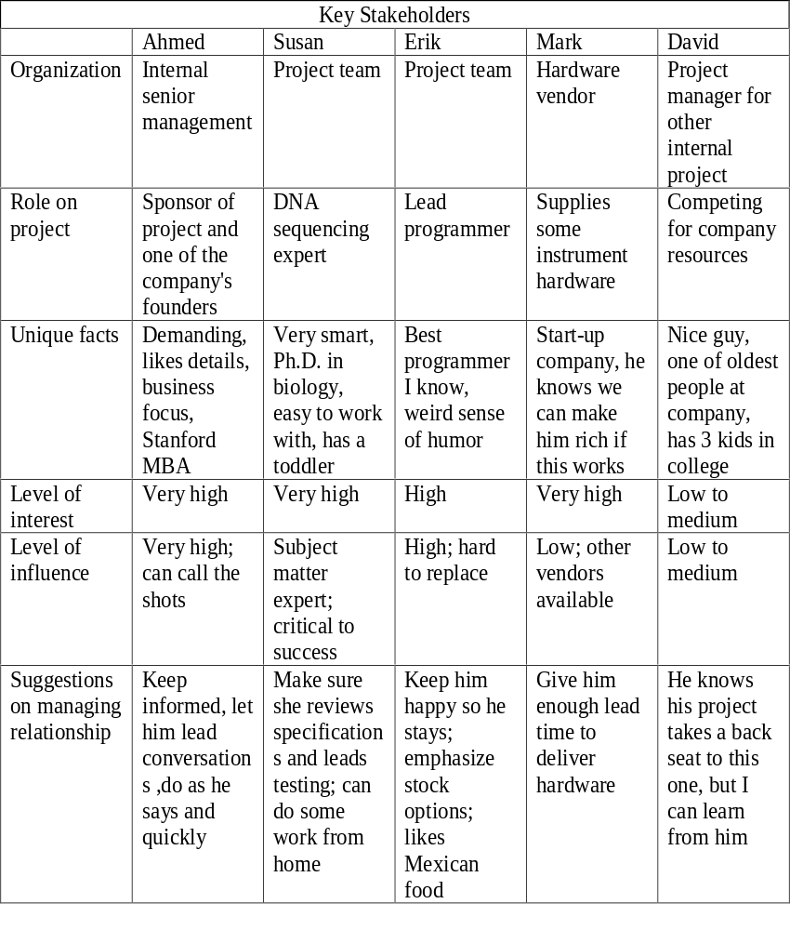
Table 4-2. Sample Stakeholder Analysis

Slide 20
Project Plan Execution
Project plan execution involves managing and performing the work described in the project plan
The majority of time and money is usually spent on execution
The application area of the project directly affects project execution because the products of the project are produced during execution

Slide 21
What Went Wrong?
Many people have a poor view of plans based on past experiences. Senior managers often require a plan, but then no one follows up on whether the plan was followed.
For example, one project manager said he would meet with each project team leader within two months to review their plans. The project manager created a detailed schedule for these reviews. He cancelled the first meeting due to another business commitment. He rescheduled the next meeting for unexplained personal reasons. Two months later, the project manager had still not met with over half of the project team leaders.
Why should project members feel obligated to follow their own plans when the project manager obviously did not follow his?

Slide 22
Important Skills for Project Execution
General management skills like leadership, communication, and political skills
Product skills and knowledge (see example of “What Went Right?” on p. 120)
Use of specialized tools and techniques

Slide 23
Tools and Techniques for Project Execution
Work Authorization System: a method for ensuring that qualified people do work at the right time and in the proper sequence
Status Review Meetings: regularly scheduled meetings used to exchange project information
Project Management Software: special software to assist in managing projects

Slide 24
Integrated Change Control
Integrated change control involves identifying, evaluating, and managing changes throughout the project life cycle (Note: 1996 PMBOK called this process “overall change control”)
Three main objectives of change control:
  Influence the factors that create changes to ensure they are beneficial
  Determine that a change has occurred
  Manage actual changes when and as they occur

Slide 25
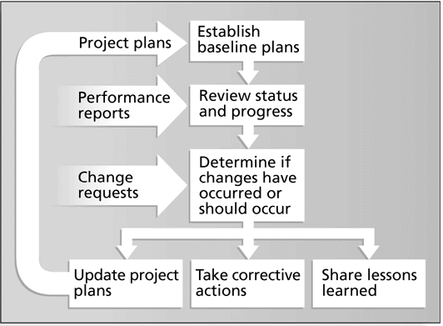
Figure 4-3. Integrated Change Control Process

Slide 26
Change Control on Information Technology Projects
Former view: The project team should strive to do exactly what was planned on time and within budget
Problem: Stakeholders rarely agreed up-front on the project scope, and time and cost estimates were inaccurate
Modern view: Project management is a process of constant communication and negotiation
Solution: Changes are often beneficial, and the project team should plan for them

Slide 27
Change Control System
A formal, documented process that describes when and how official project documents and work may be changed
Describes who is authorized to make changes and how to make them
Often includes a change control board (CCB), configuration management, and a process for communicating changes

Slide 28
Change Control Boards (CCBs)
A formal group of people responsible for approving or rejecting changes on a project
CCBs provide guidelines for preparing change requests, evaluate change requests, and manage the implementation of approved changes
Includes stakeholders from the entire organization

Slide 29
Making Timely Changes
Some CCBs only meet occasionally, so it may take too long for changes to occur
Some organizations have policies in place for time-sensitive changes
  “48-hour policy” allows project team members to make decisions, then they have 48 hours to reverse the decision pending senior management approval
  Delegate changes to the lowest level possible, but keep everyone informed of changes

Slide 30
Configuration Management
Ensures that the products and their descriptions are correct and complete
Concentrates on the management of technology by identifying and controlling the functional and physical design characteristics of products
Configuration management specialists identify and document configuration requirements, control changes, record and report changes, and audit the products to verify conformance to requirements

Slide 31
Table 4-3. Suggestions for Managing Integrated Change Control
    View project management as a process of constant communications and negotiations
    Plan for change
    Establish a formal change control system, including a Change Control Board (CCB)
    Use good configuration management
    Define procedures for making timely decisions on smaller changes
    Use written and oral performance reports to help identify and manage change
    Use project management and other software to help manage and communicate changes

Slide 32
Using Software to Assist in Project Integration Management
Several types of software can be used to assist in project integration management
  Documents can be created with word processing software
  Presentations are created with presentation software
  Tracking can be done with spreadsheets or databases
  Communication software like e-mail and Web authoring tools facilitate communications
  Project management software can pull everything together and show detailed and summarized information (see Appendix A for details)

Slide 33
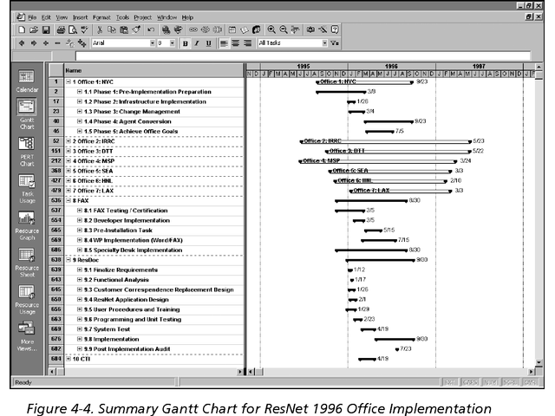
ResNet Summary Gantt Chart

Slide 34
Questions for discussion
Review and discuss the opening case. Answer the following questions:
  What was the real problem in this case?
  Was Nick a good project manager?
  Why or why not?
  What could he have done to improve the situation, and what should senior management have done?

